Slide 1
Pubbies hate him! Get yourself the right premium tank with this single trick!
A presentation by a long time Wot-addict, Jurgen Xhafaj

Slide 2

DISCLAIMER
I do have over 20.000 battles on this game, where each battle lasts 2~15minutes, depending on :
how bad your team is
matchmaker
how well the teammates are coordinated
the efficiency of your tank (assuming your tank is any good)
The data was extracted from Vbaddict.net (overall stats of NA server on last 30 days) and at worldoftanks.com (my stats), and WarGaming.net (premium shop details).

Slide 3
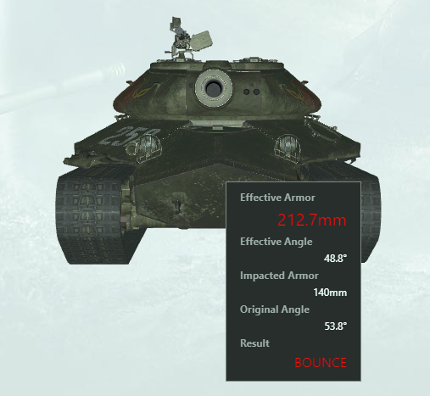
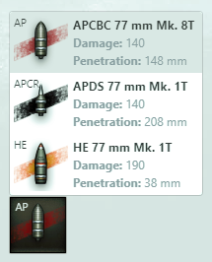
Overview
Do you ever feel like your tank sucks?
Ever been 1v1 against a Defender and could not penetrate the thing’s armor even with premium ammo?
Do you want your tank to last twice longer in battle than its non-premium peers?
If you answered YES to any of these, keep reading!
You have come to the right place! And all you need is my database! (and a credit card)
Defender’s “weakspot”
Your gun ( lol )

Slide 4
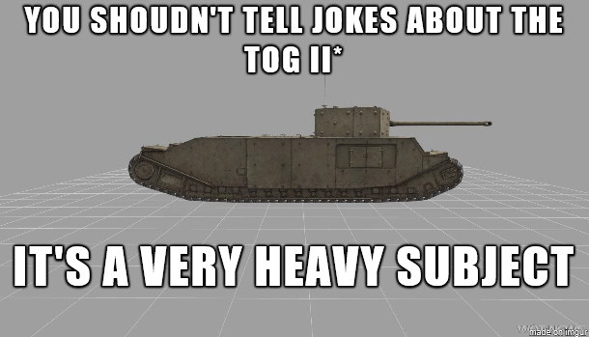
NAME_LU table
ID (number 4,0) -- given to a specific tank
NAME (VARCHAR2, 26 Bytes) -- common name/alias for the tank
FULL_NAME (VARCHAR2, 128 Bytes) -- the actual name of the tank
TIER (NUMBER 1,0) -- there are premium tanks at tier 2~8
COUNTRY (VARCHAR2, 26 Bytes) -- country that produced the tank
CLASS (VARCHAR2, 3 Bytes) -- class of tank (LT=light tank, MT=medium tank, HT=heavy tank, TD=tank destroyer, SPG=self propelled gun)
P.S. TOG sucks!

Slide 5


PREM_SHOP TABLE
NAME (VARCHAR2, 26 Bytes) -- common name/alias for the tank
PREM_SHOP_NA (VARCHAR2, 1Byte) -- Is the tank on NA premium shop? (Y/N)
TECH_TREE (VARCHAR2, 2Bytes) -- Is the tank on tech tree? (Y/N/RM=removed)
PREM_SHOP_EU (VARCHAR2, 1Byte) -- Is the tank on EU premium shop? (Y/N)
PREM_SHOP_SEA (VARCHAR2, 1Byte) -- Is the tank on SEA premium shop? (Y/N)
PREM_SHOP_RU (VARCHAR2, 1Byte) -- Is the tank on RU premium shop? (Y/N)

Slide 6
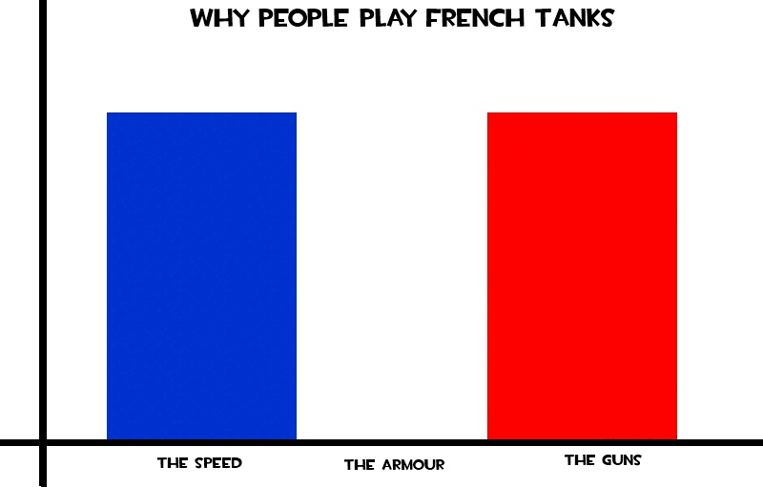
NATIONS TABLE
CD (VARCHAR2, 2 Bytes) -- code for each respective country
COUNTRY (VARCHAR2, 26 Bytes) -- country that produced the tank
FULL_COUNTRY_NAME (VC2, 128 Bytes) -- full name of each country

Slide 7
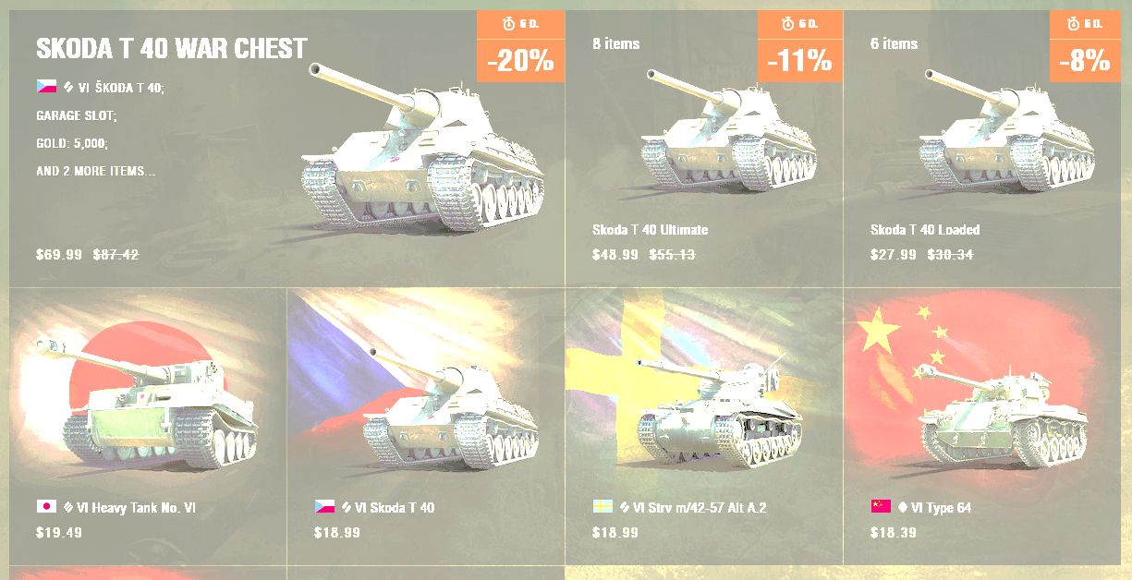
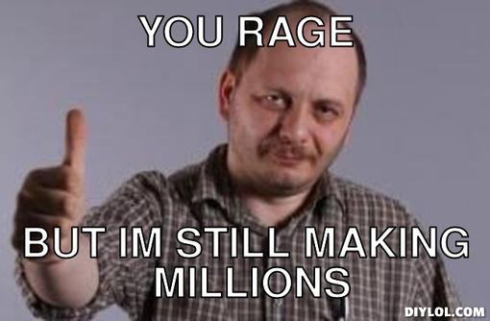
PRICES TABLE
NAME (VARCHAR2, 26 Bytes) -- common name/alias for the tank
TIER (NUMBER 1,0) -- there are premium tanks at tier 2~8
MIN_BUNDLE (NUMBER 4,2) -- minimal price for a tank / tank bundle
PREF_MM (VARCHAR2, 1 Byte) -- preferential (easier) matchmaking
LAST_SOLD (DATE) -- date when the tank was last sold
CD (VARCHAR2, 2 Bytes) -- code for each respective country

Slide 8
BATTLE_STATS TABLE
ID (number 4,0) -- given to a specific tank
NR_BATTLES (number 8,0) -- nr of battles fought in NA server for the past 30 days
WIN_RATE (number 6,2) -- win rate in that tank in NA battles for the past 30 days
DAMAGE (number 7,2) -- damage dealt by a tank in NA battles for the past 30 days

Slide 9
MY_STATS TABLE
NAME (VARCHAR2, 26 Bytes) -- common name/alias for the tank
IN_GARAGE (VARCHAR2, 1 Byte) -- Do I have this tank in my garage? (Y/N)
MY_BATTLES (number 5,0) -- nr of battles I have fought on this tank (overall)
WIN_RATE (number 6,2) -- win rate that I have on this tank (overall)
DAMAGE (number 7,2) -- damage that I have dealt while playing this tank (per game)
OPINION (VARCHAR2, 3 Bytes) -- my opinion on the tank (OP/OK/BAD/POS)

Slide 10
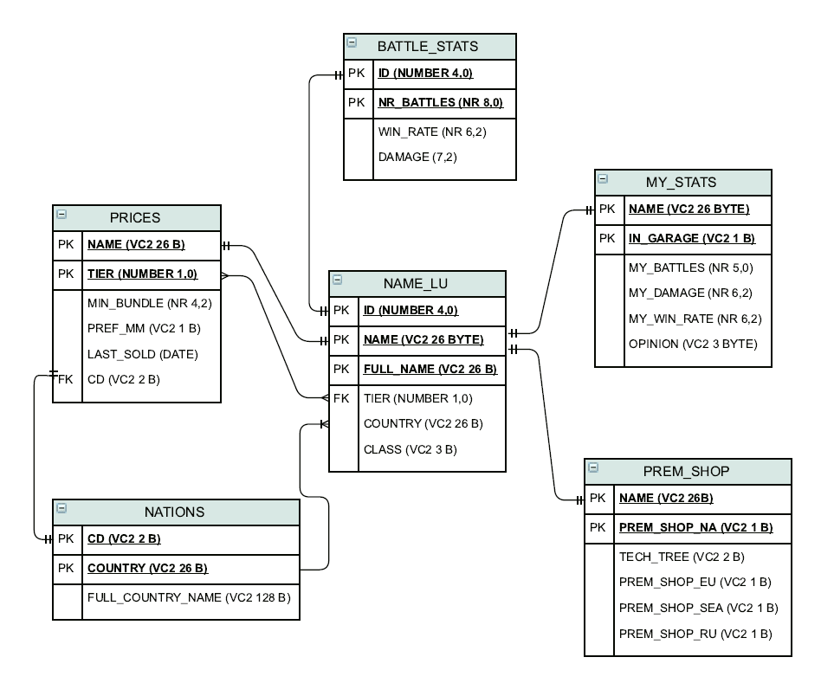
ERD for my database

